Slide 1


CAPSTONE PROJECT NOVEMBER, 2019
Filipe Falcão

Slide 2
1. Introduction:
⁃ The problem to be solved.
2. Data Section:
⁃ Data requirements and Sources.
3. Methodology section:
⁃ Data processing, data analysis and/or inferential statistical testing performed, and/or machine learnings used.
4. Results section:
⁃ Presentation of the results/finding.
5. Discussion section:
⁃ Observations & recommendations
6. Conclusion section:
⁃ Answers & conclusions.
SCHEDULE

Slide 3
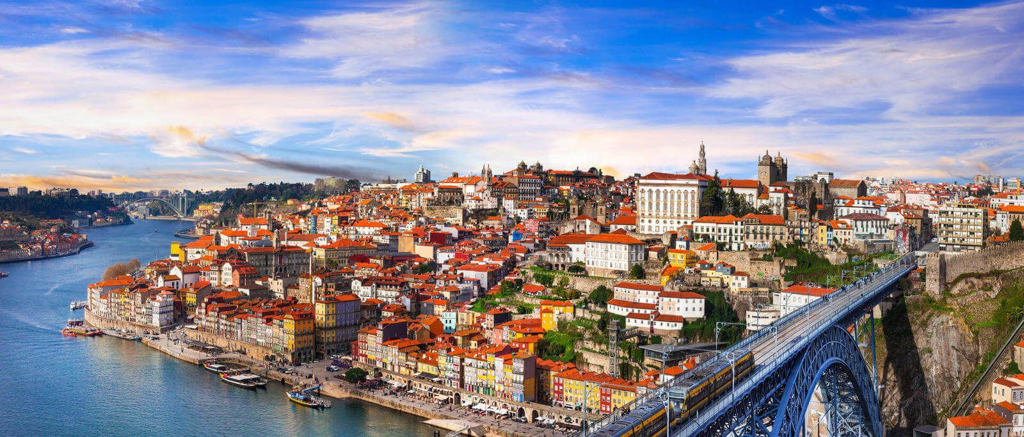
1. INTRODUCTION
Hello everyone,
My name is Filipe! Welcome to Oporto, my sweet hometown.

Slide 4
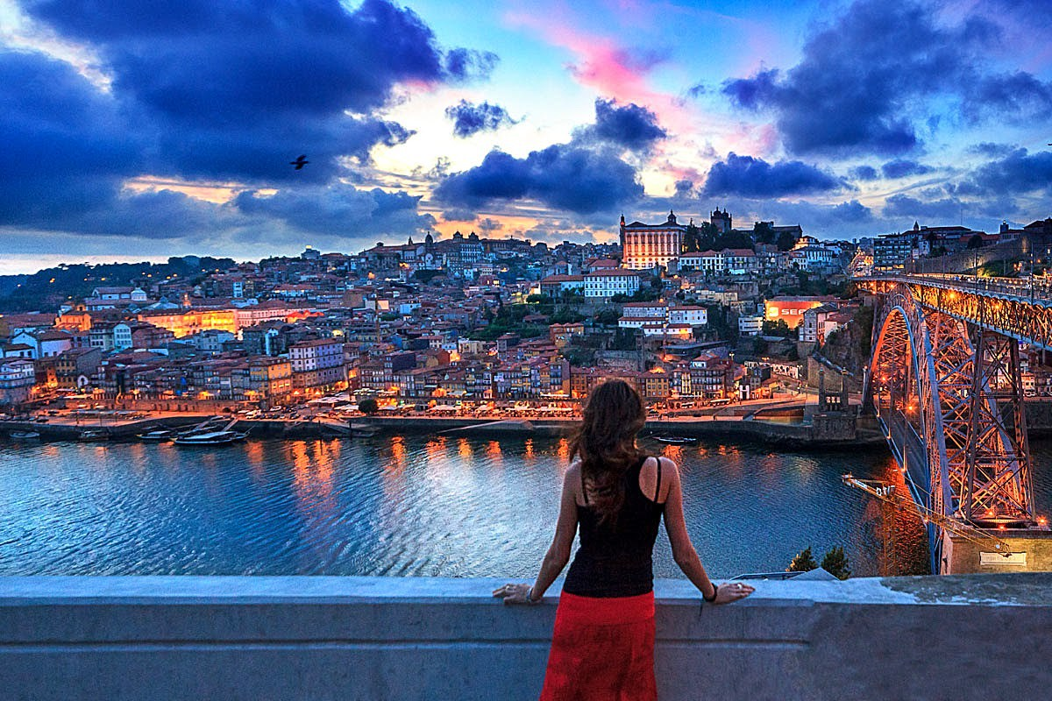
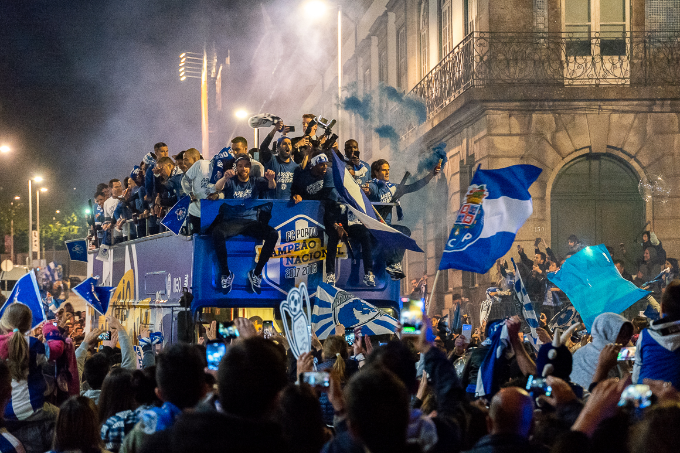
1. INTRODUCTION
Oporto is a historic place.
It is a charismatic city, with proud
residents.
Filled with beautiful monuments and
breathtaking landscapes, as well as home
of one of the most famous football clubs
in the world (FC Porto), it is not
surprising that the "undefeated city “
is a popular destination for tourists
worldwide.

Slide 5
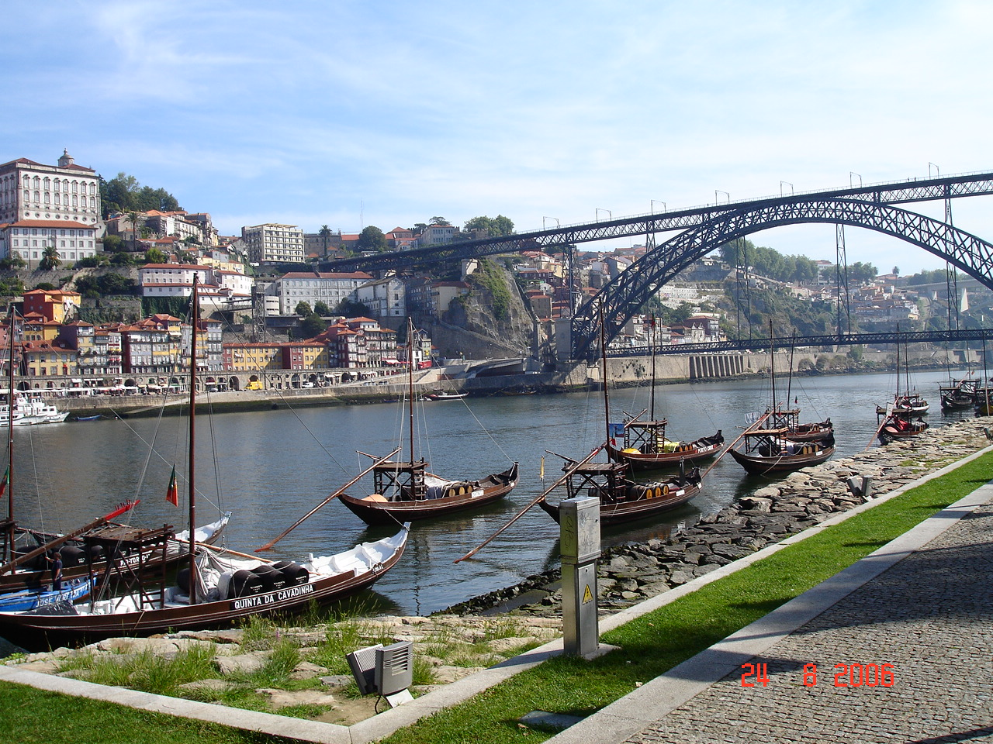
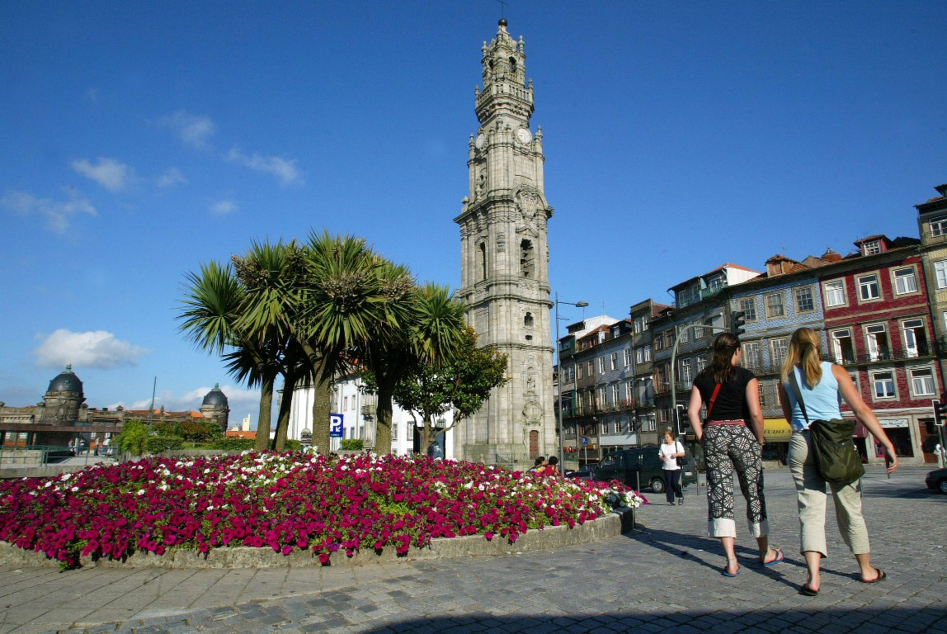
1. INTRODUCTION
- The problem to be solved:
Given the growing wave of tourism in Oporto, a hotel building group is interested in opening a hotel in the city. They want to know what would be the best place in the city to open a hotel.
About Oporto:
Oporto is made up of 15 locations:
Aldoar | Massarelos
Bonfim | Miragaia
Campanhã | Nevogilde
Cedofeita | Paranhos
Foz do Douro | Ramalde
Lordelo do Ouro | Santo Ildefonso
São Nicolau | Sé
Vitória

Slide 6
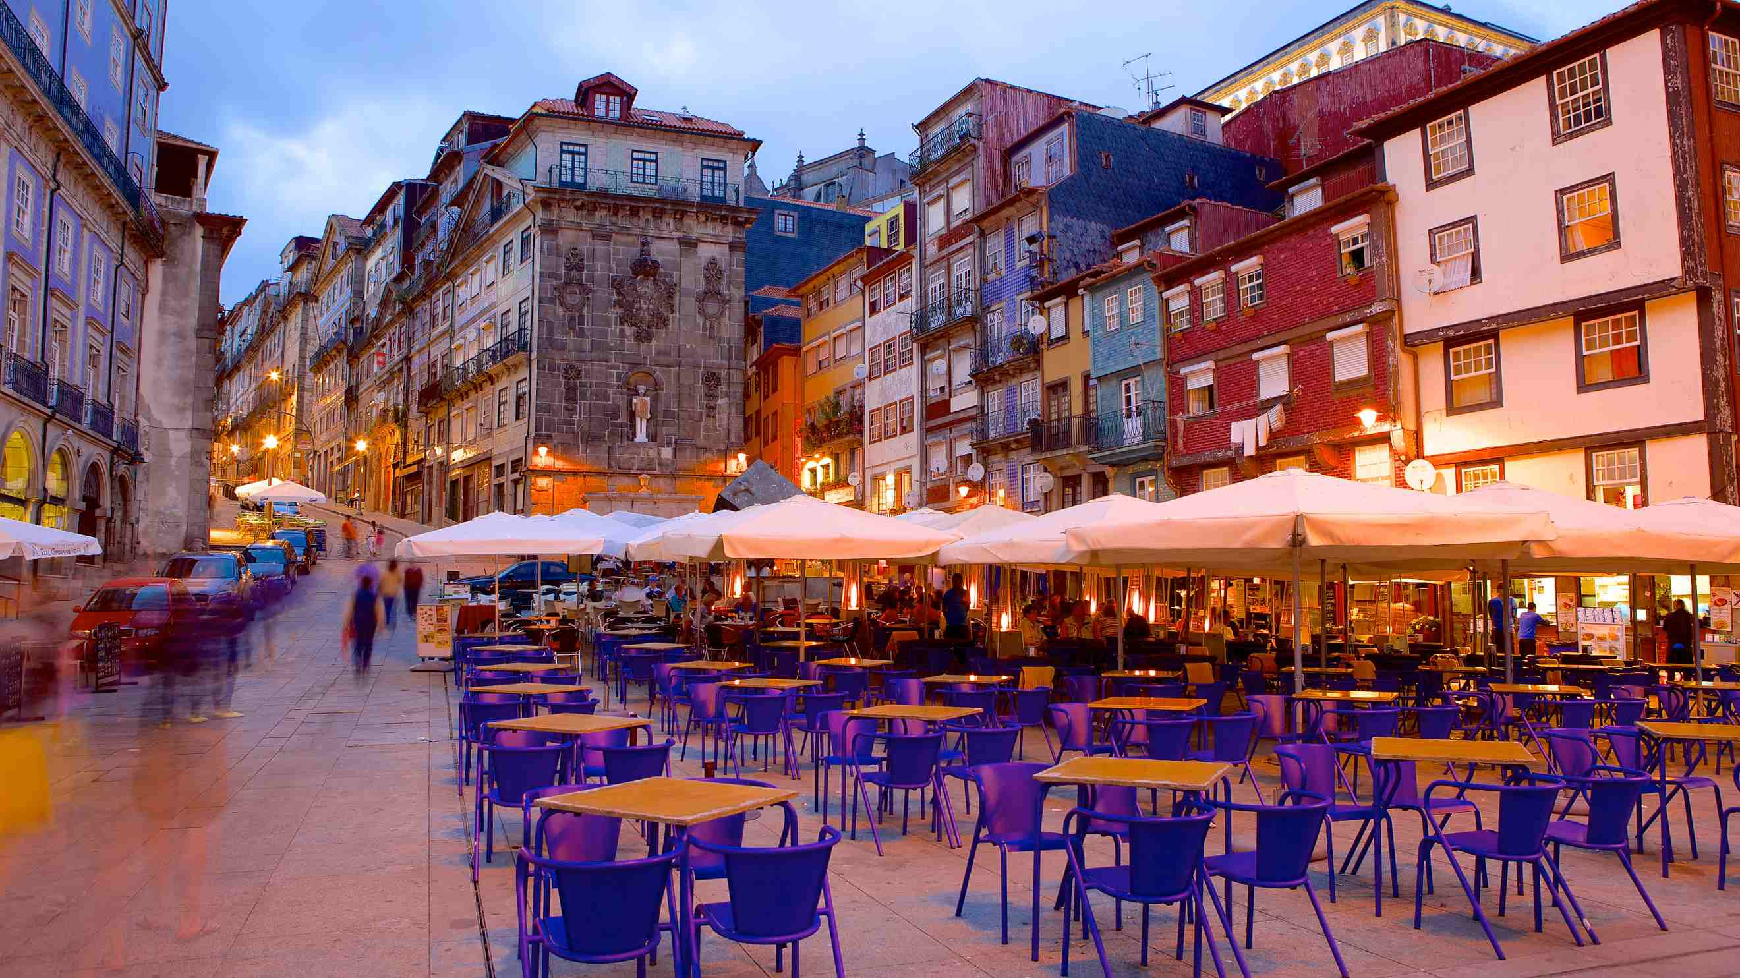
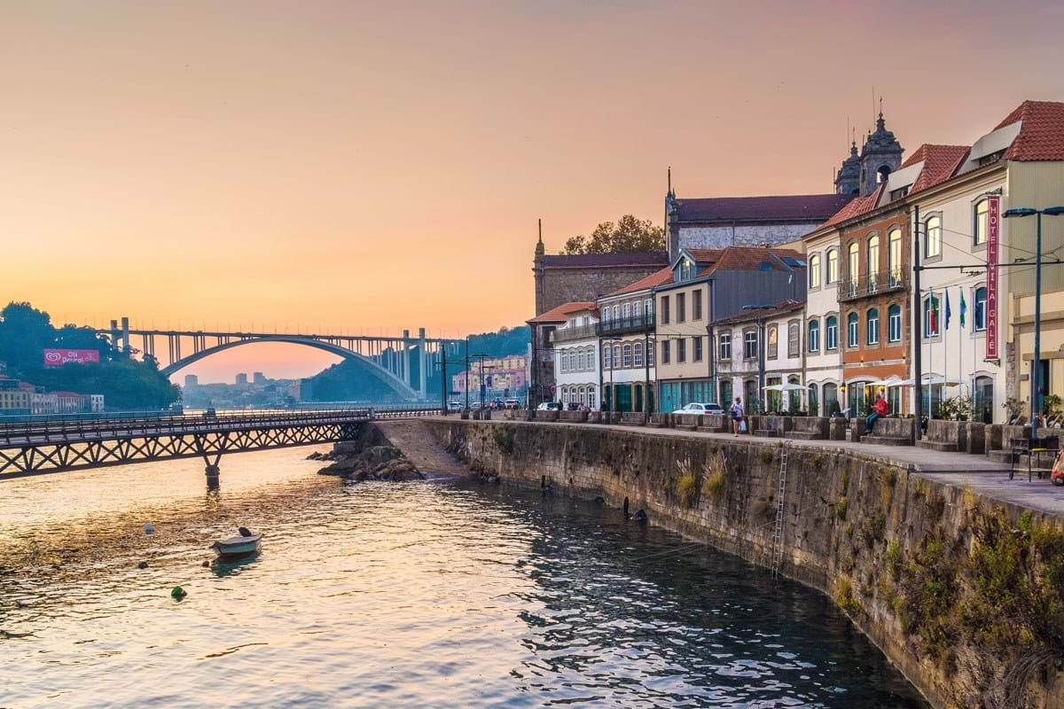
1. INTRODUCTION
What do we need?
We need to choose the best Locality in Oporto to
Build a hotel.
The ideal place to open a city hotel should take into
account the following characteristics:
Low amount of competition (other hotels)
Presence of several nearby restaurants
Near nightlife establishments
Near the city's monuments and other art and leisure sources
Easy subway access for tourists to move around the city in peace
Who would be interested in this project (Target Audience):
Hotel investors
Tourists
Traders.
Residents

Slide 7
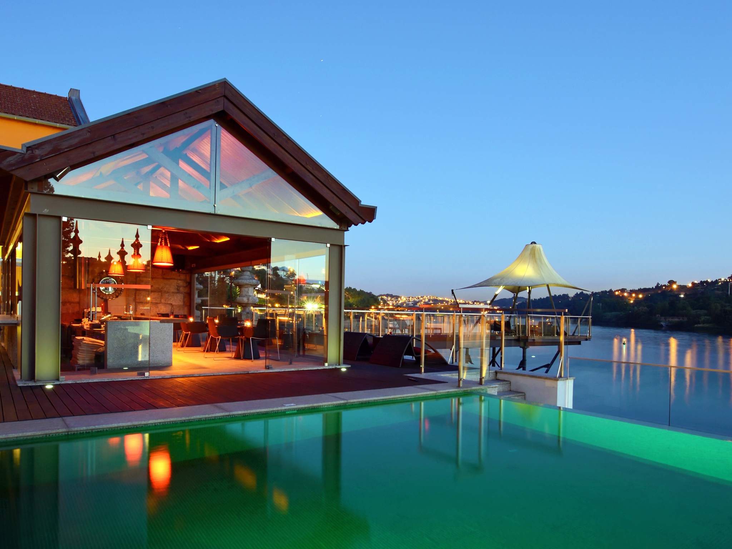
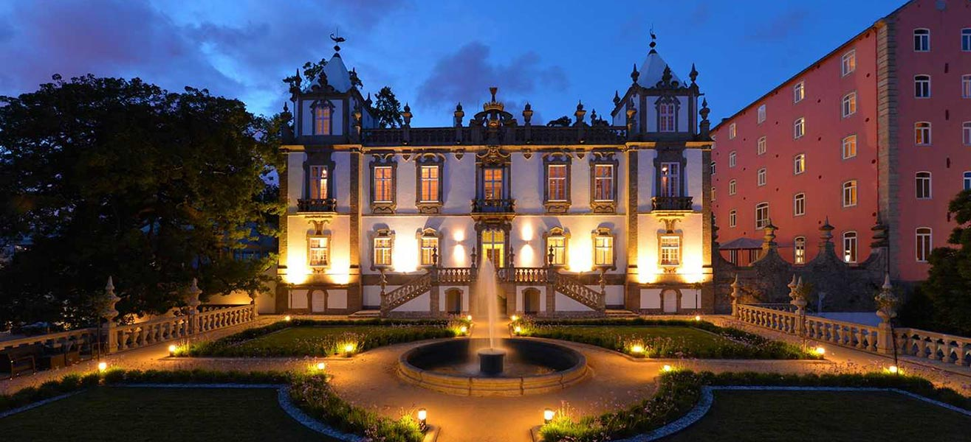
2. DATA SECTION
- The data we need:
The localities of Oporto and their coordinates
(latitude, longitude).
- Venues of the localities we need from Foursquare:
Hotels
Restaurants
Nightlife establishments
Art and Leisure Sources
Subway stations

Slide 8
3. METHODOLOGY
1) I collected, for each locality, all hotels, restaurants, night establishments, art and leisure places and subway stations venues data from Foursquare.
2) Then, i computed, for each locality, the sums of the hotels, restaurants, night establishments, art and leisure places and subway stations
3) For each category, a weight (or penalty) has been defined according to what we think is important for a hotel to be successful:
Category | Weight
Hotels | -1.0
Restaurants | 1.0
Night Establishments | 1.0
Sybway stations | 1.5
Art and leisure | 1.5
4) At last, i computed a score for each locality
as the weighted sum of the
number of venues in each of the categories above.

Slide 9
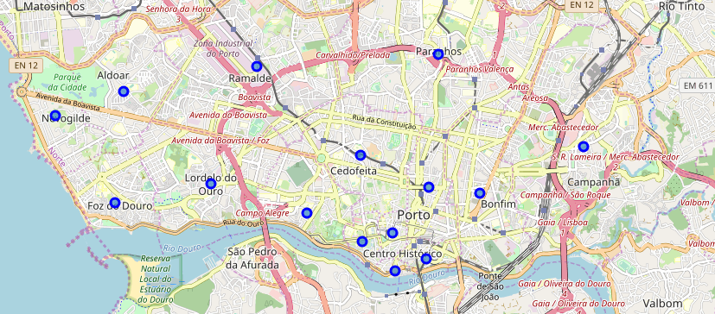
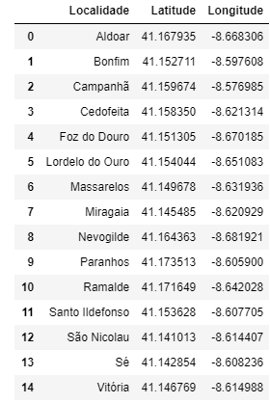
4. Results:
Map of Oporto
Localities

Slide 10
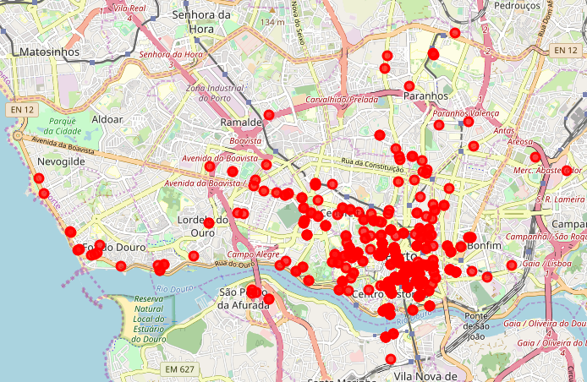
4. Results:
Map of Oporto
Hotels

Slide 11
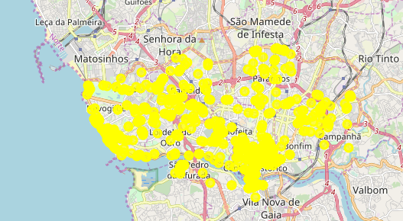
4. Results:
Map of Oporto
Restaurants

Slide 12
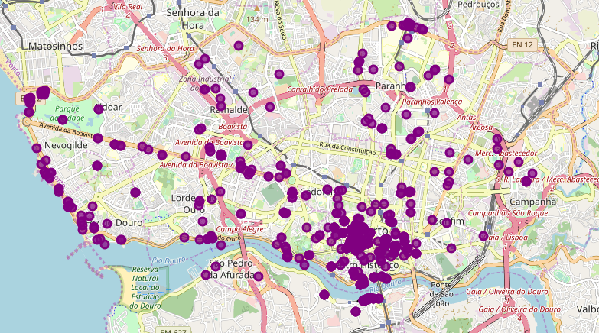
4. Results:
Map of Oporto
Night Establishments

Slide 13
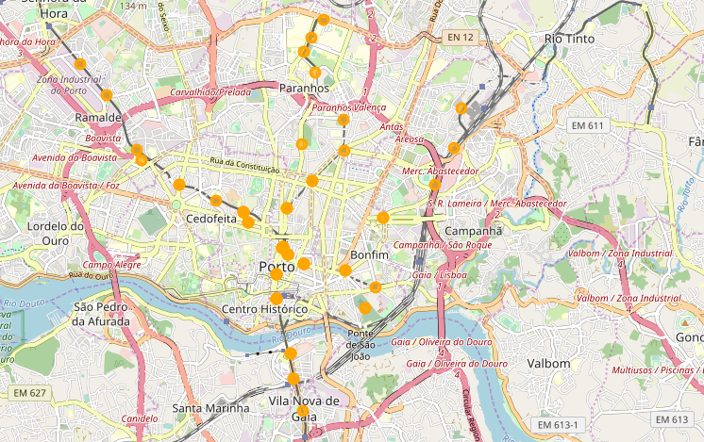
4. Results:
Map of Oporto
Subway stations

Slide 14
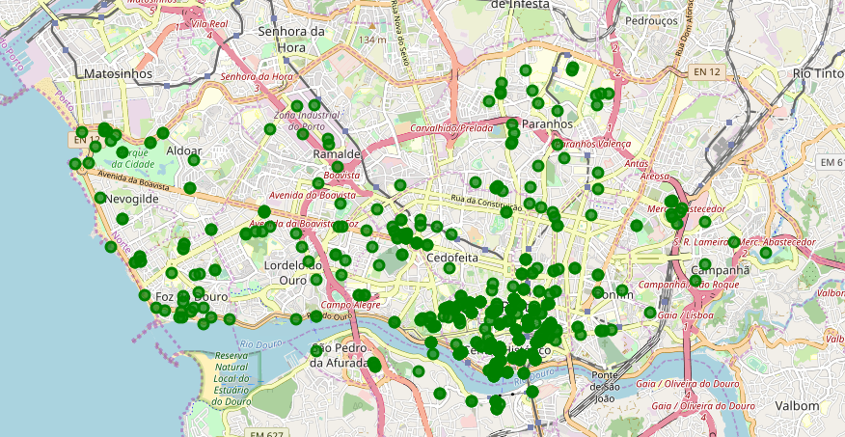
3. Results:
Map of Oporto
Art and Leisure places

Slide 15
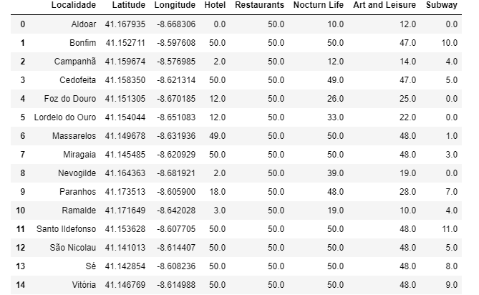
4. Results:
Score results
Without weights

Slide 16
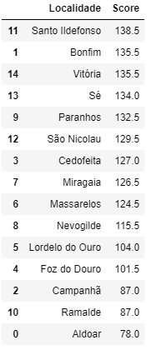
4. Results:
Score results
With weights
The locality with best score is “Santo Ildefonso” with 138.5 pts.
With this result we maximize the number of potential tourists who will visit the hotels.

Slide 17
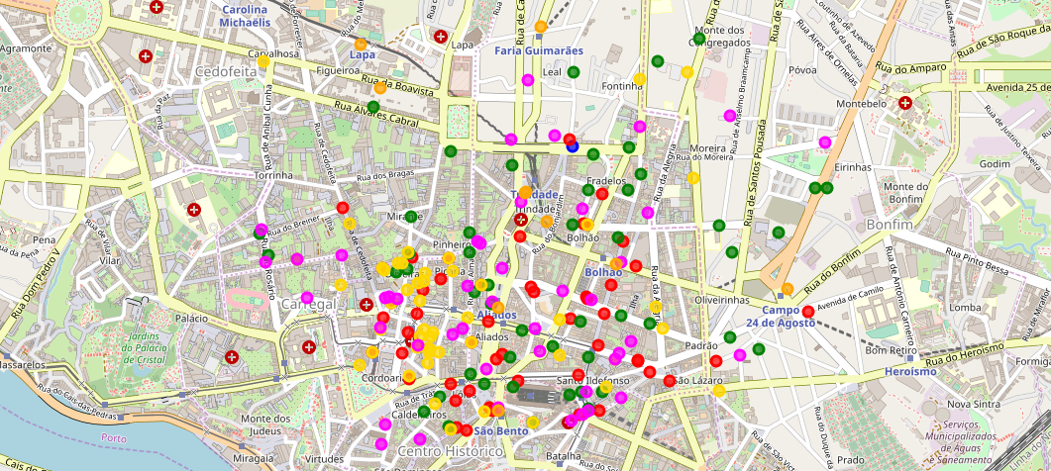
4. DISCUSSION
Red - Restaurants
Green - Hotels
Gold - Night Establishments
Fuchsia - Art and Leisure
Orange - Subway stations
The new hotel should be located inside the circle.

Slide 18
THANK YOU FOR YOUR ATTENTION.

